Slide 1


Lecture 6
Junction characterisation
Jon Major
Nov 6th 2014

Slide 2
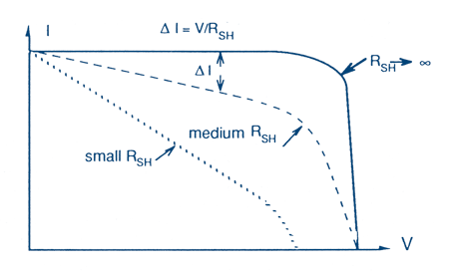

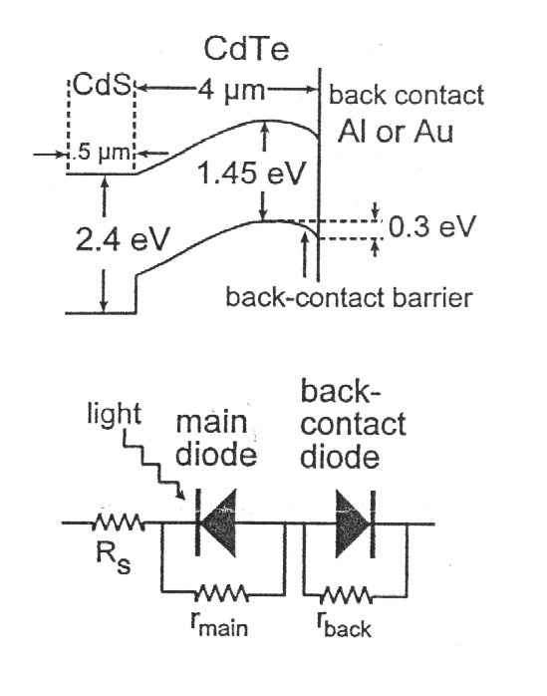
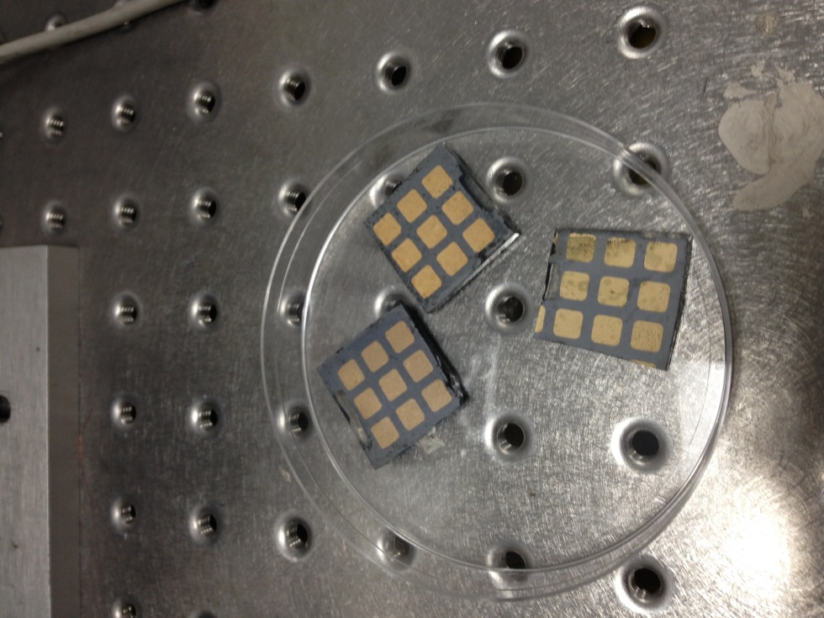
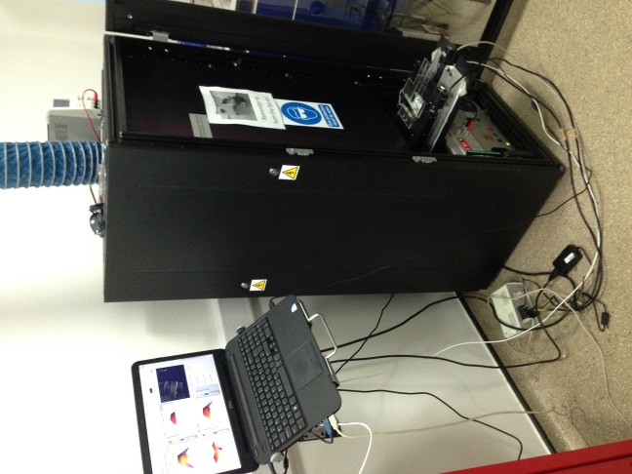
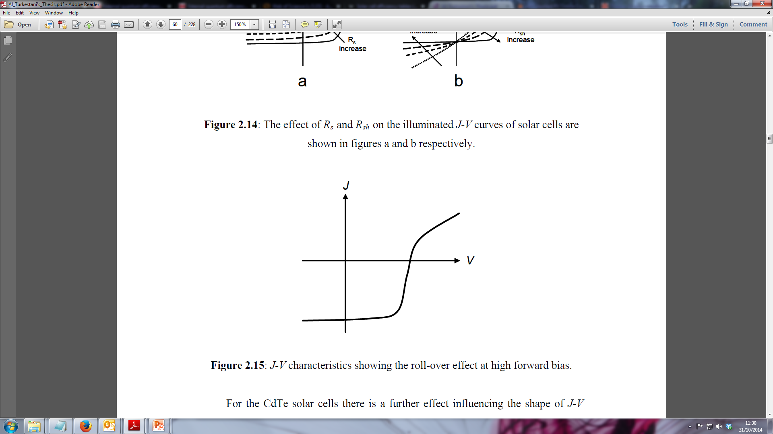


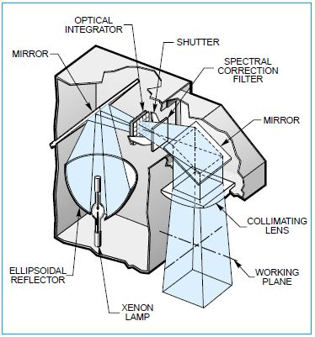

L6
The PV research cycle
Make cells
Measure cells
Repeat
Data
Despair

Slide 3
LX
Lecture Outline
Key junction characterisation techniques
Analysis of current voltage (J-V) curves
External quantum efficiency (EQE) measurements
Capacitance voltage (C-V) measurements

Slide 4
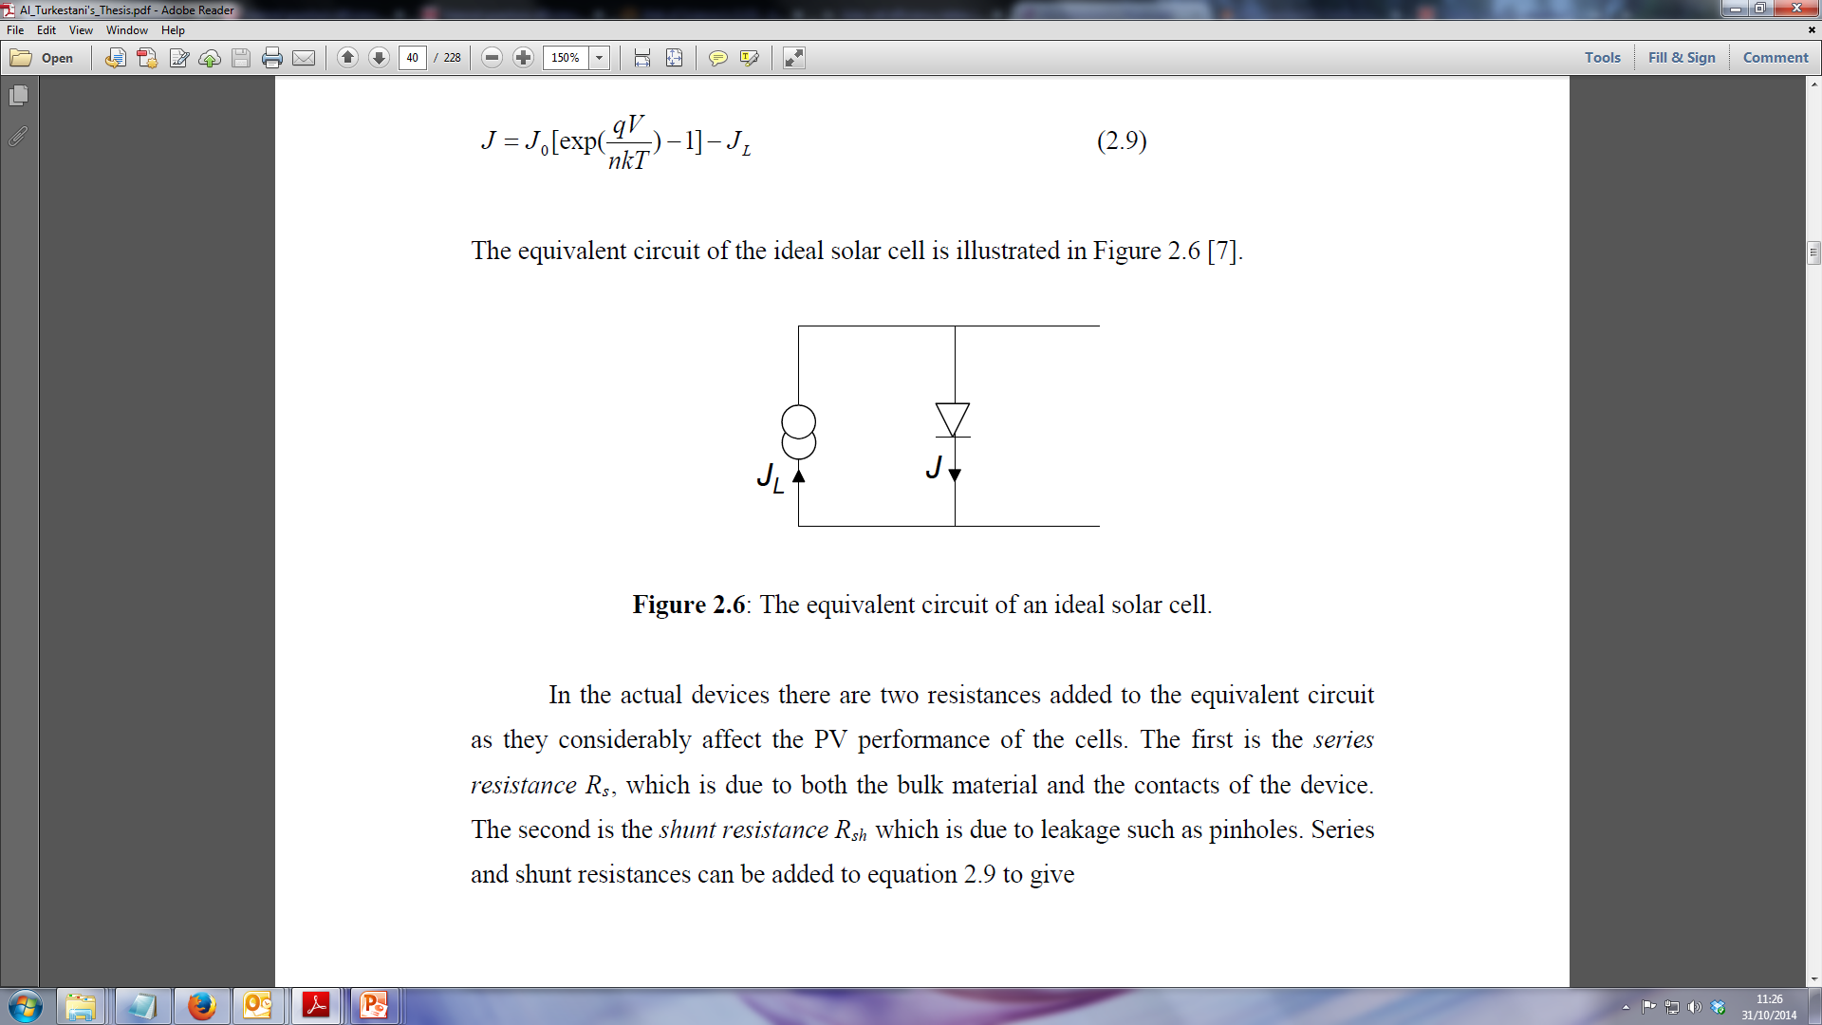
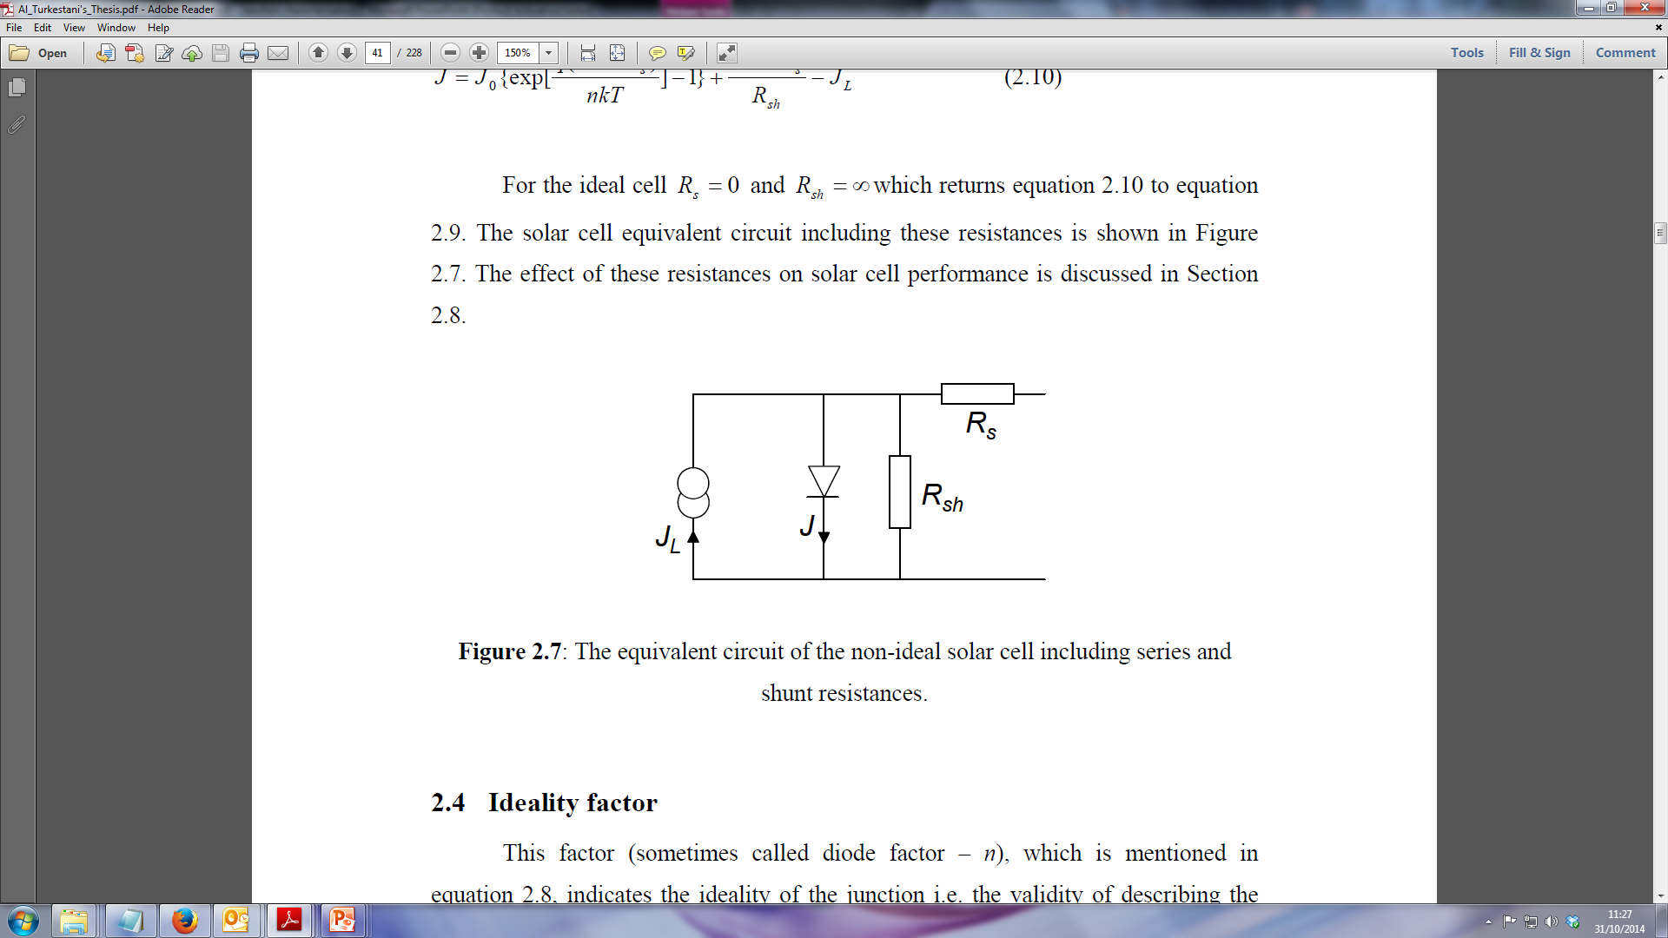
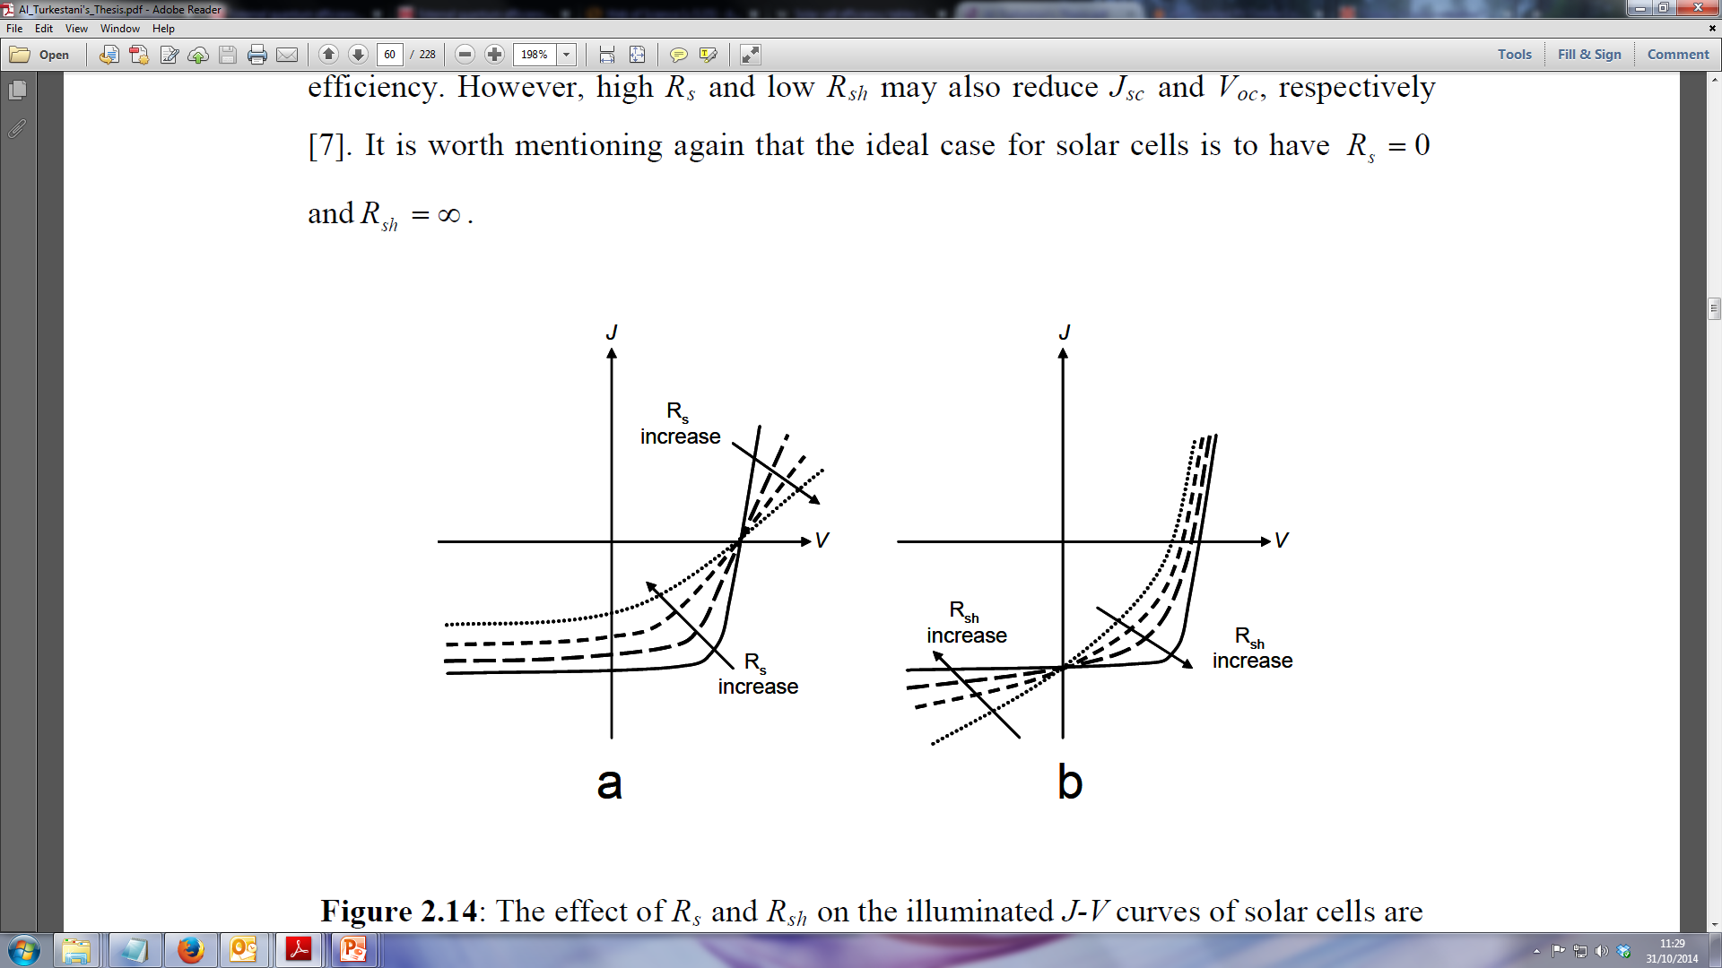

L6
J-V analysis (J-V)
Parasitic resistances
Perfect p-n junction
Real p-n junction
A good device should have low R_{S}
And high R_{Sh}

Slide 5
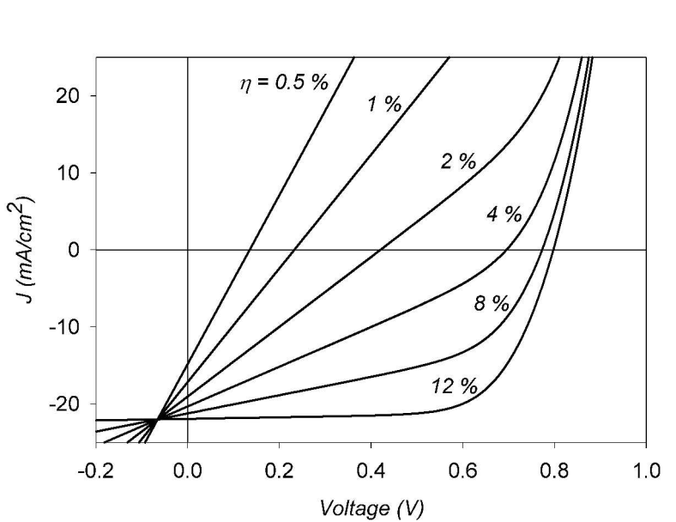
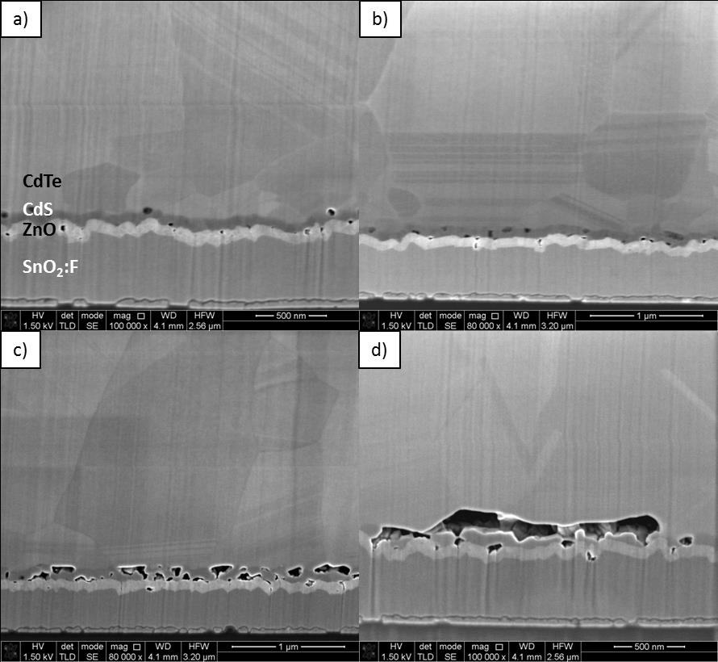
L6
J-V analysis (J-V)
R_{s}
R_{sh}
Causes of high R_{S} values
Overly thick absorber layer
Low conductivity TCO
Low doping levels
Causes of low R_{Sh} values
Pinholes in layers
Weak diode regions

Slide 6
R_{s}
R_{sh}
L6
J-V analysis (J-V)

Slide 7
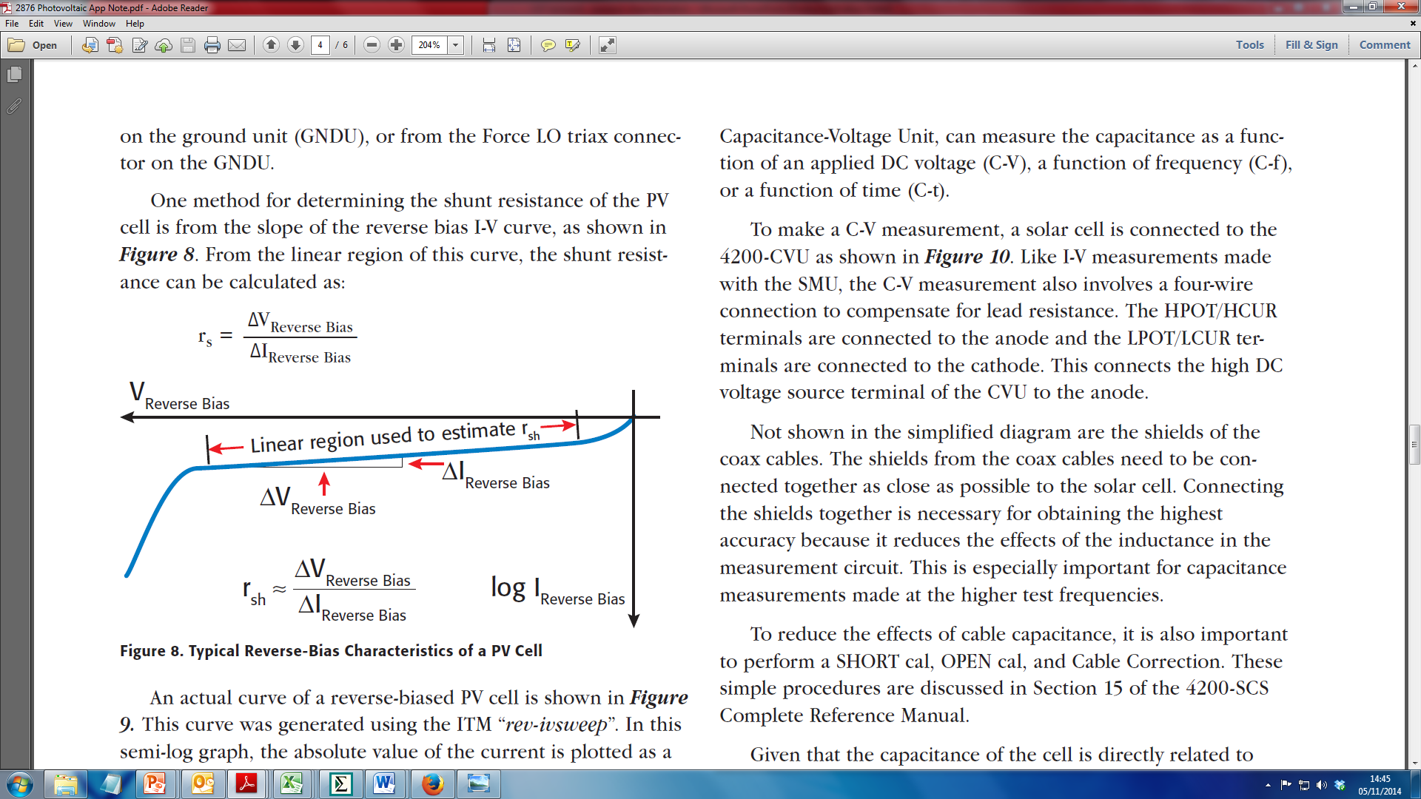
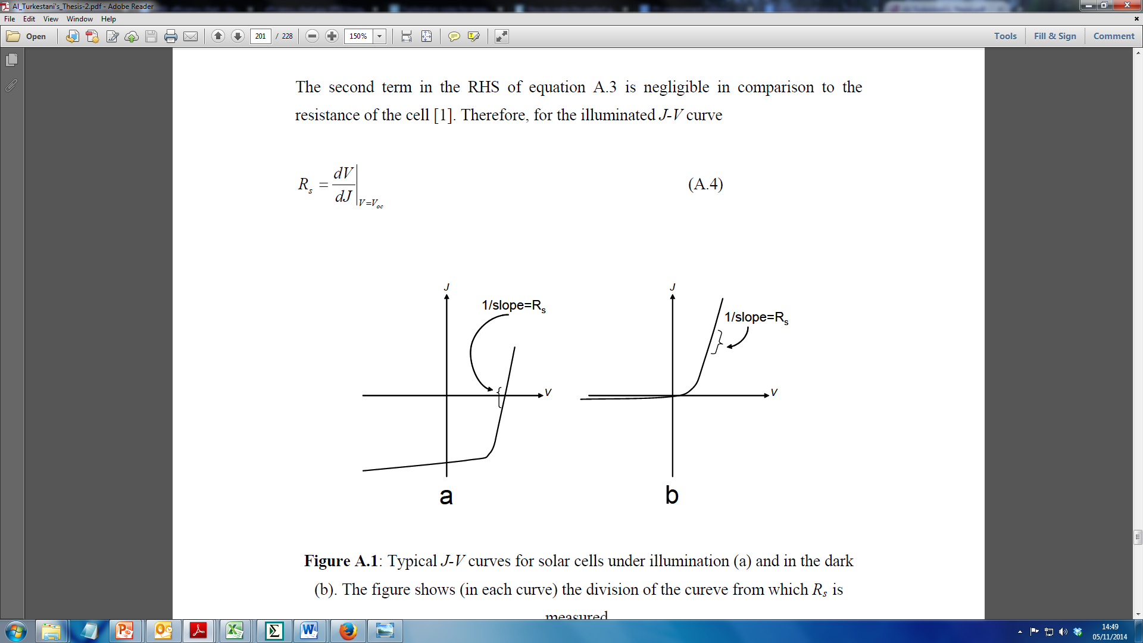
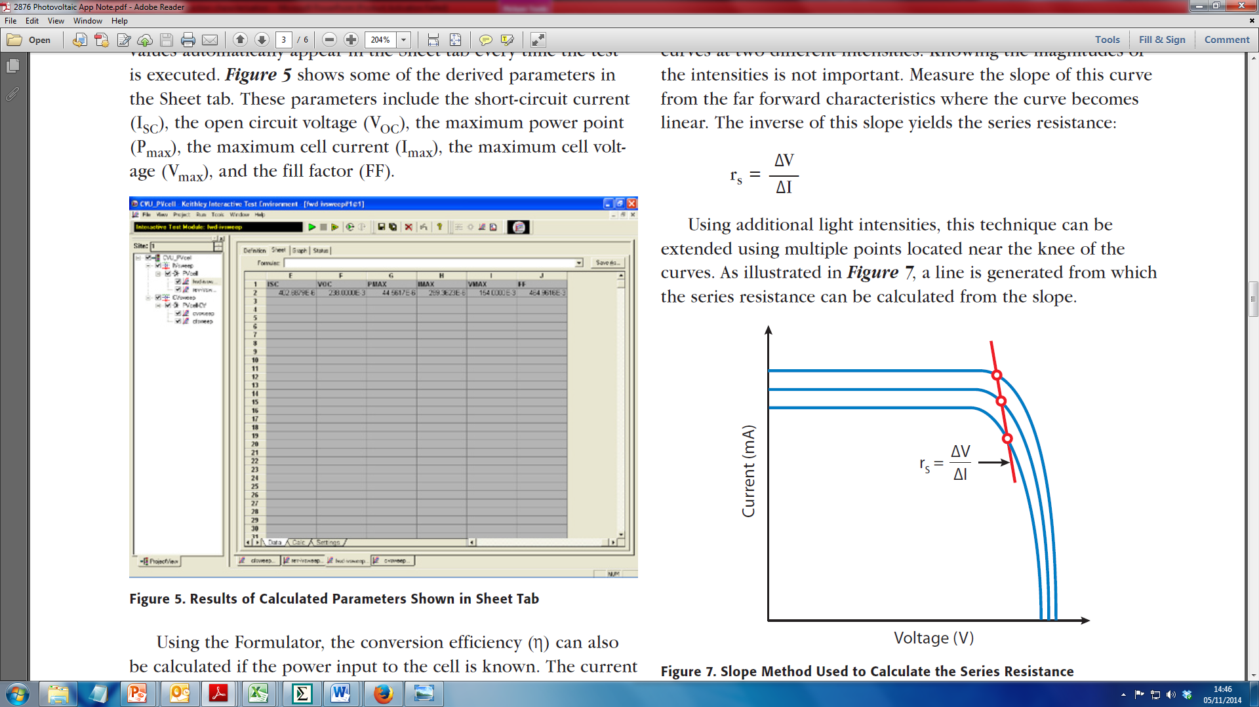
L6
J-V analysis (J-V)
To determine R_{sh} fit to straight line portion of JV curve in reverse bias
A
B
R_{s} can be more difficult to accurately determine. Two common methods
Fit to forward bias region of curve
Measure change as function of light bias

Slide 8
L6
J-V analysis (J-V)
If a non-ohmic contact is formed this results in the creation of a back contact junction diode.
“Roll-over”
This back-contact diode opposes the main junction diode and leads to the phenomenon of “roll-over” at high forward bias.

Slide 9
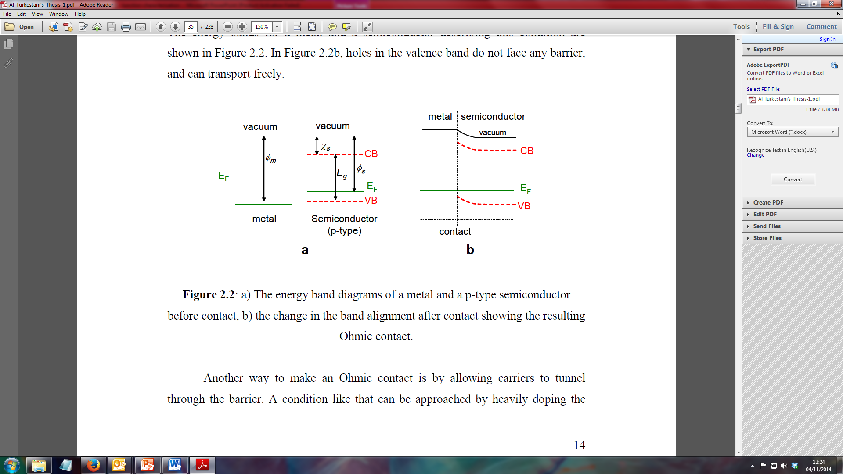
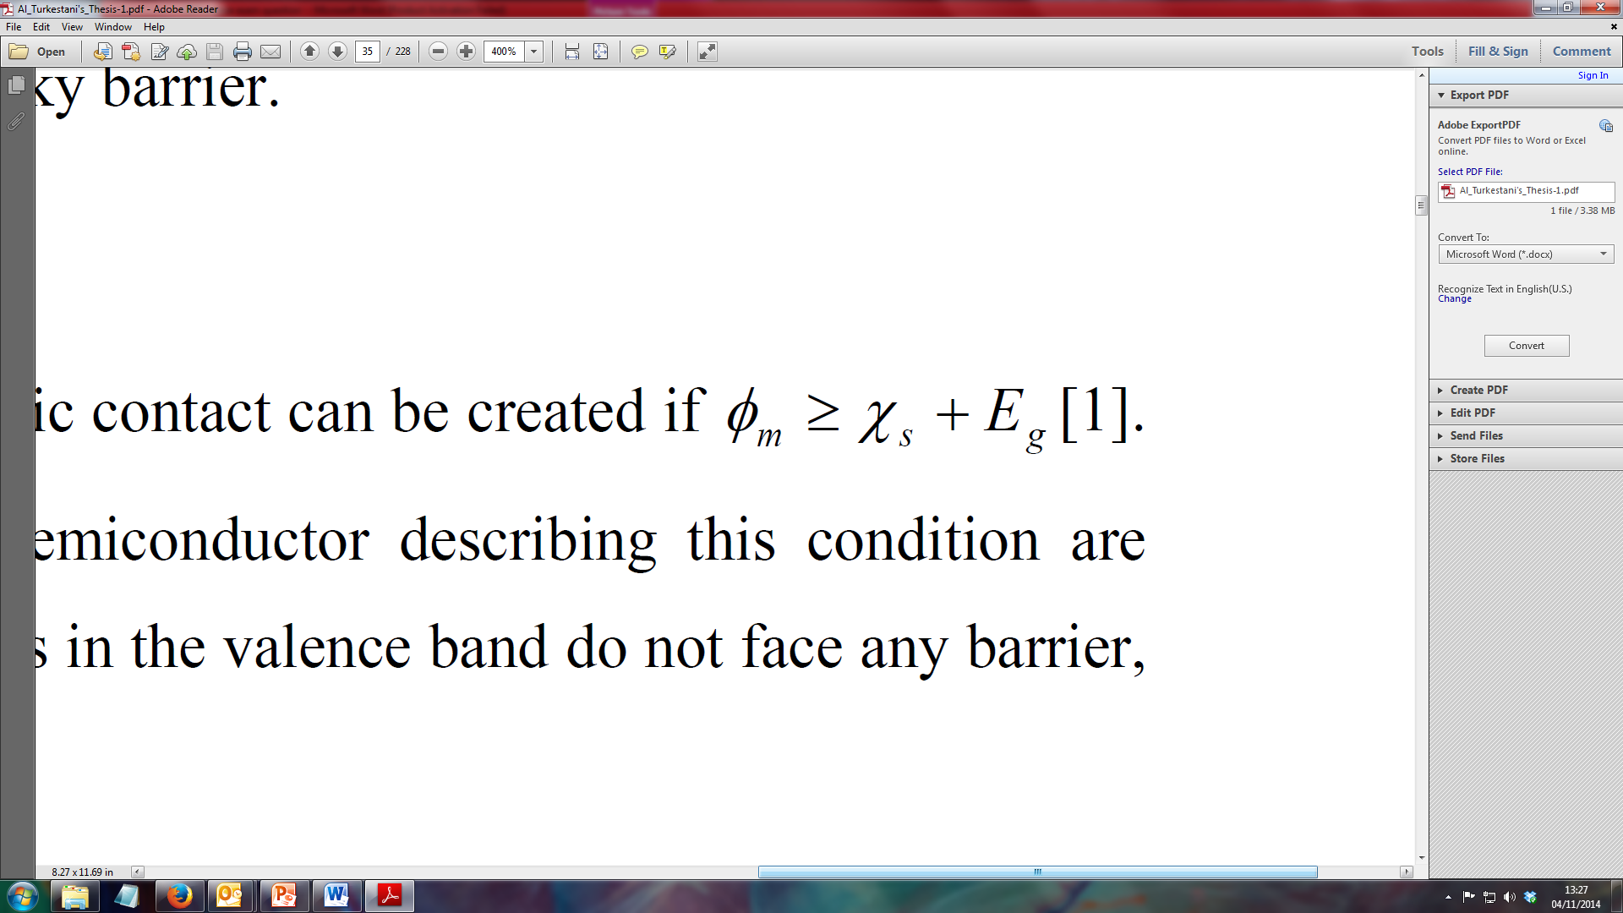
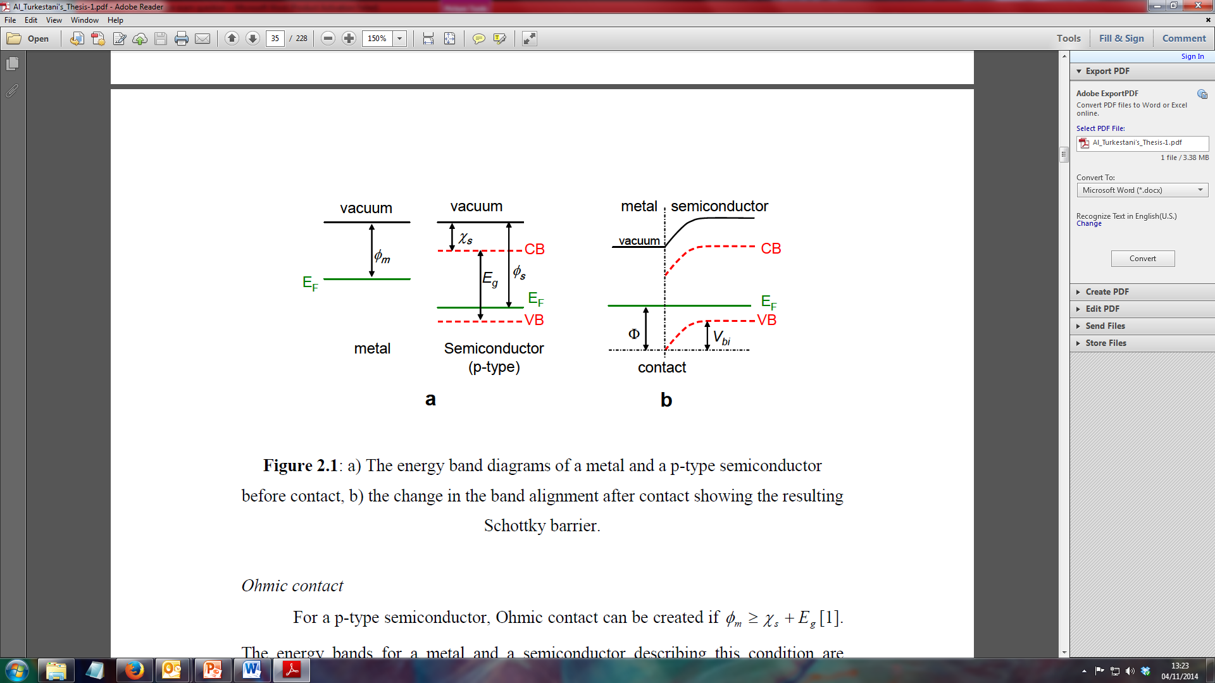
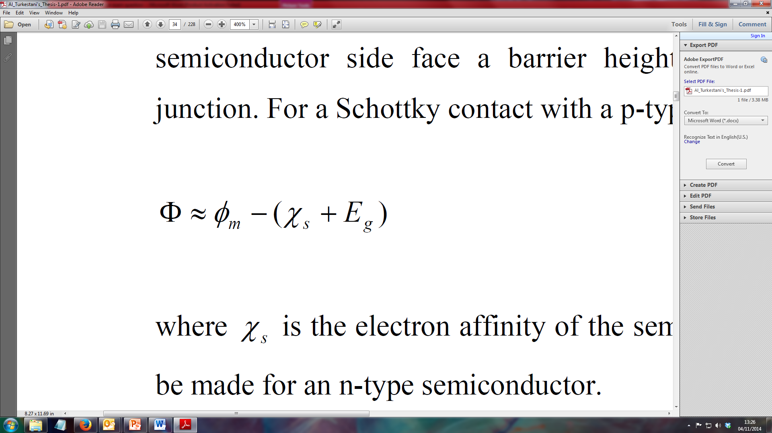
L6
J-V analysis (J-V)
Ohmic contact
For a p-type semiconductor can create an ohmic contact if;
Metal work function
Electron affinity
Bandgap
Schottky barrier
If this condition is not met we introduce a back contact Schottky barrier
Back contact barrier height

Slide 10
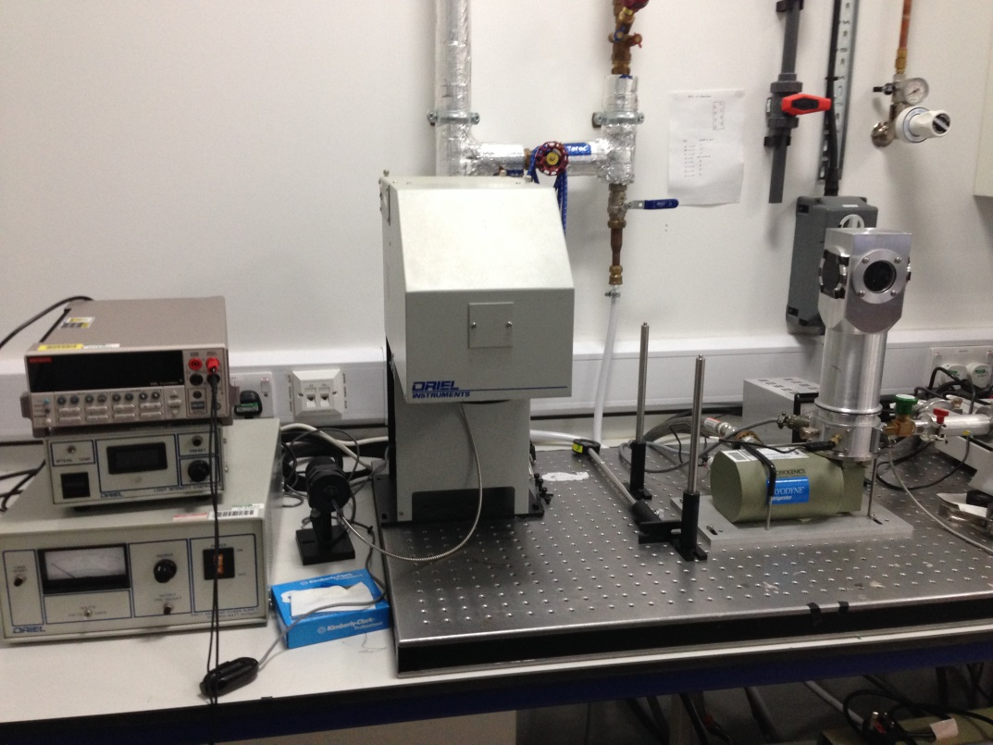
L6
J-V-T analysis
Influence of barrier height changes as a function of temperature
By measuring J-V curves as a function of temperature we can extract the barrier height
This back-contact diode opposes the main junction diode and leads to the phenomenon of “roll-over” at high forward bias.

Slide 11
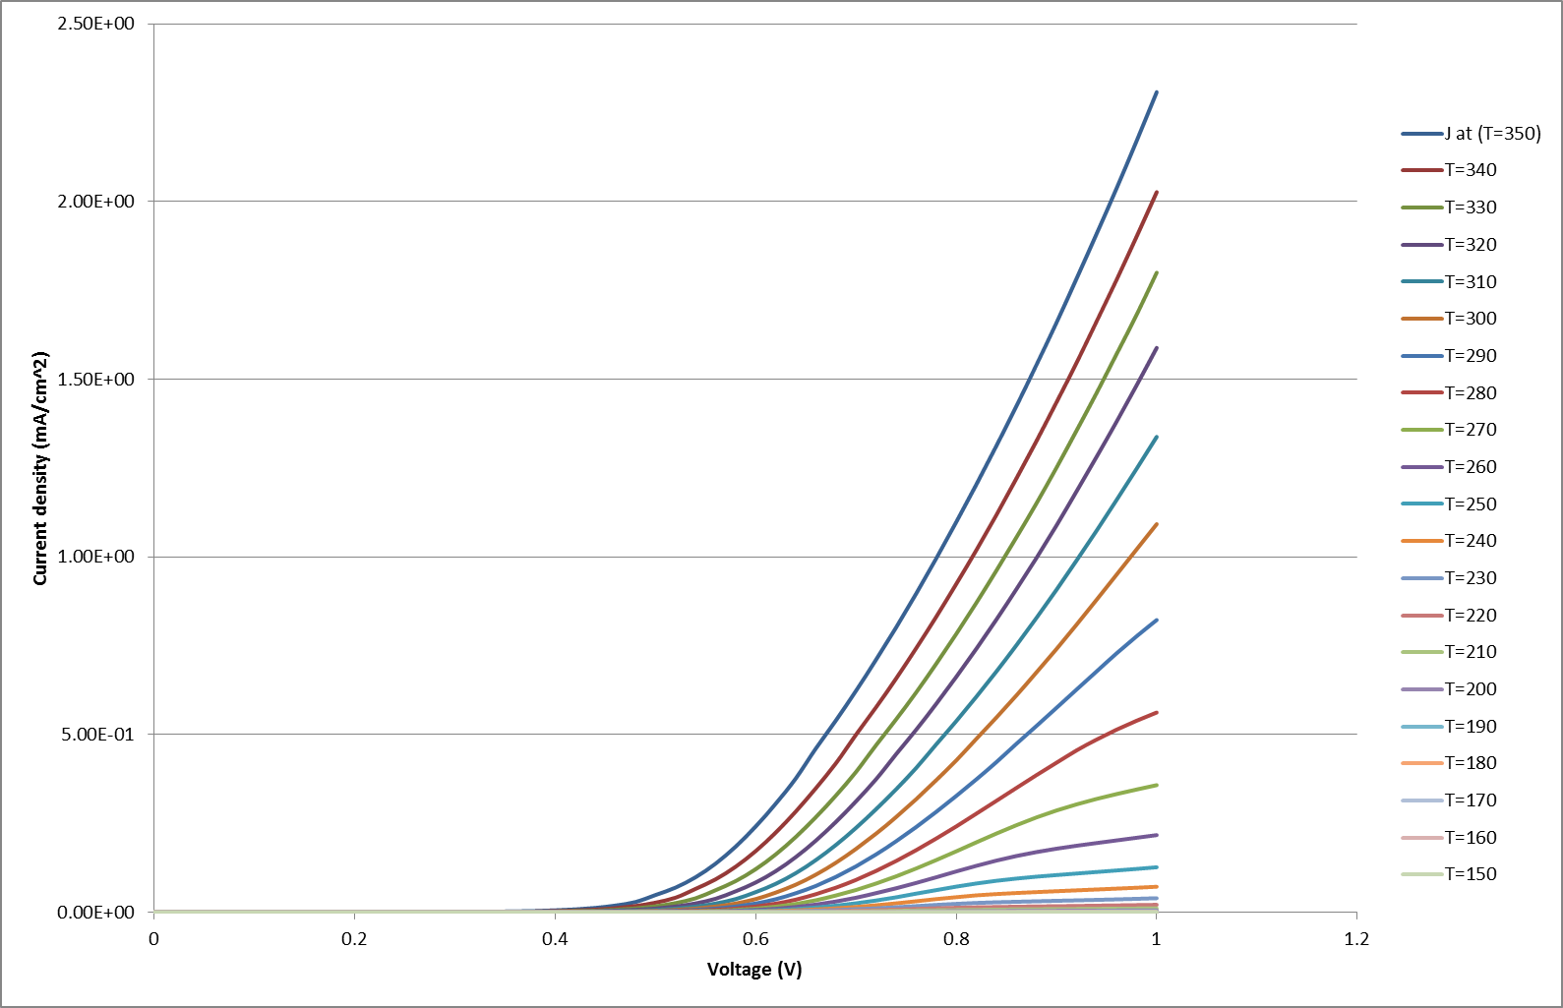
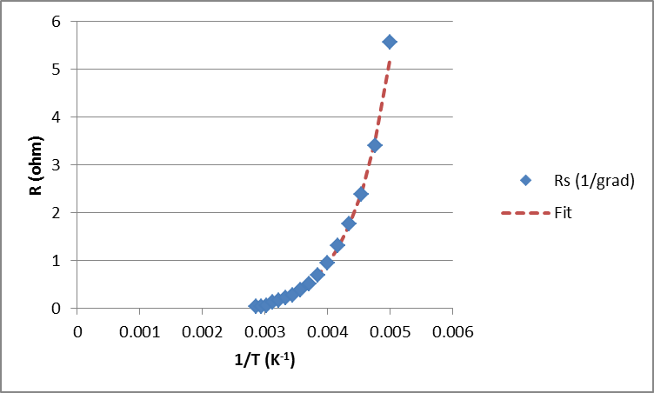
L6
J-V-T analysis
Series resistance varies with temperature via
Ohmic resistance
Ohmic temperature
dependence
Measure R_{S}
Fitting to exponential region allows us to extract a value in eV for the barrier height. Generally anything < 0.3eV is considered a good contact
If a non-ohmic contact is formed this results in the creation of a back contact junction diode.

Slide 12
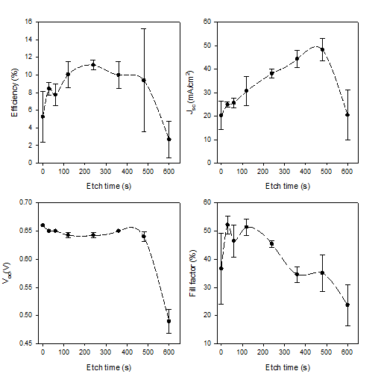
L6
A cautionary tale

Slide 13
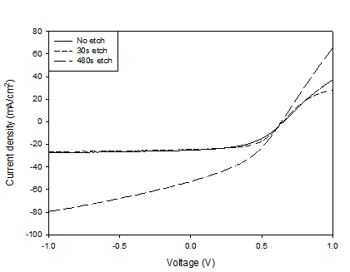
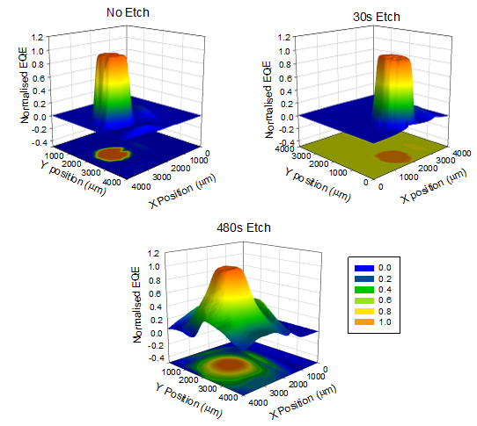
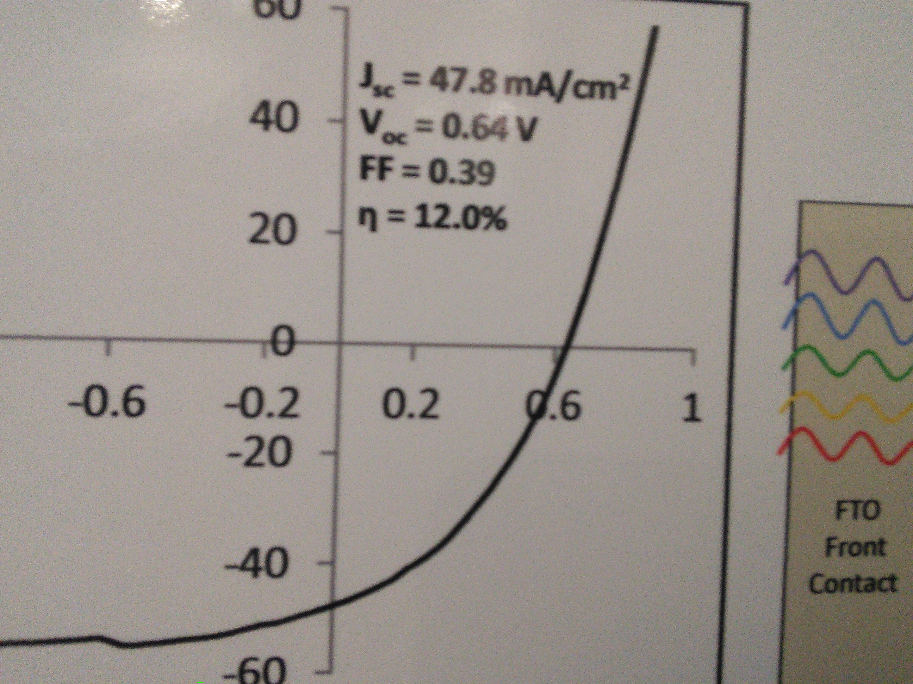
L6
Errors in J-V analysis (J-V)
High Voc and FF are reliable
J_{sc} values are very sensitive to calibration or contact size errors
Contacts should be minimum of 0.25cm²
If it looks to good to be true it usually is!

Slide 14
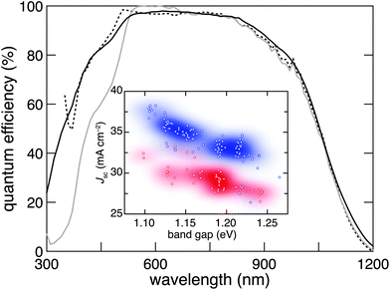
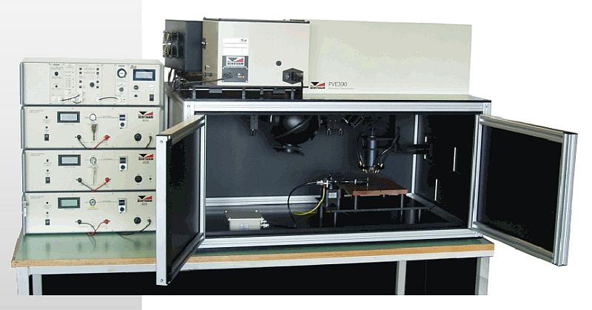
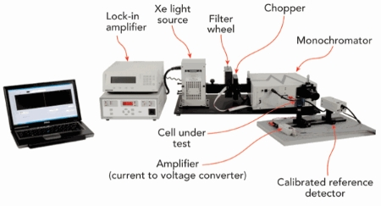
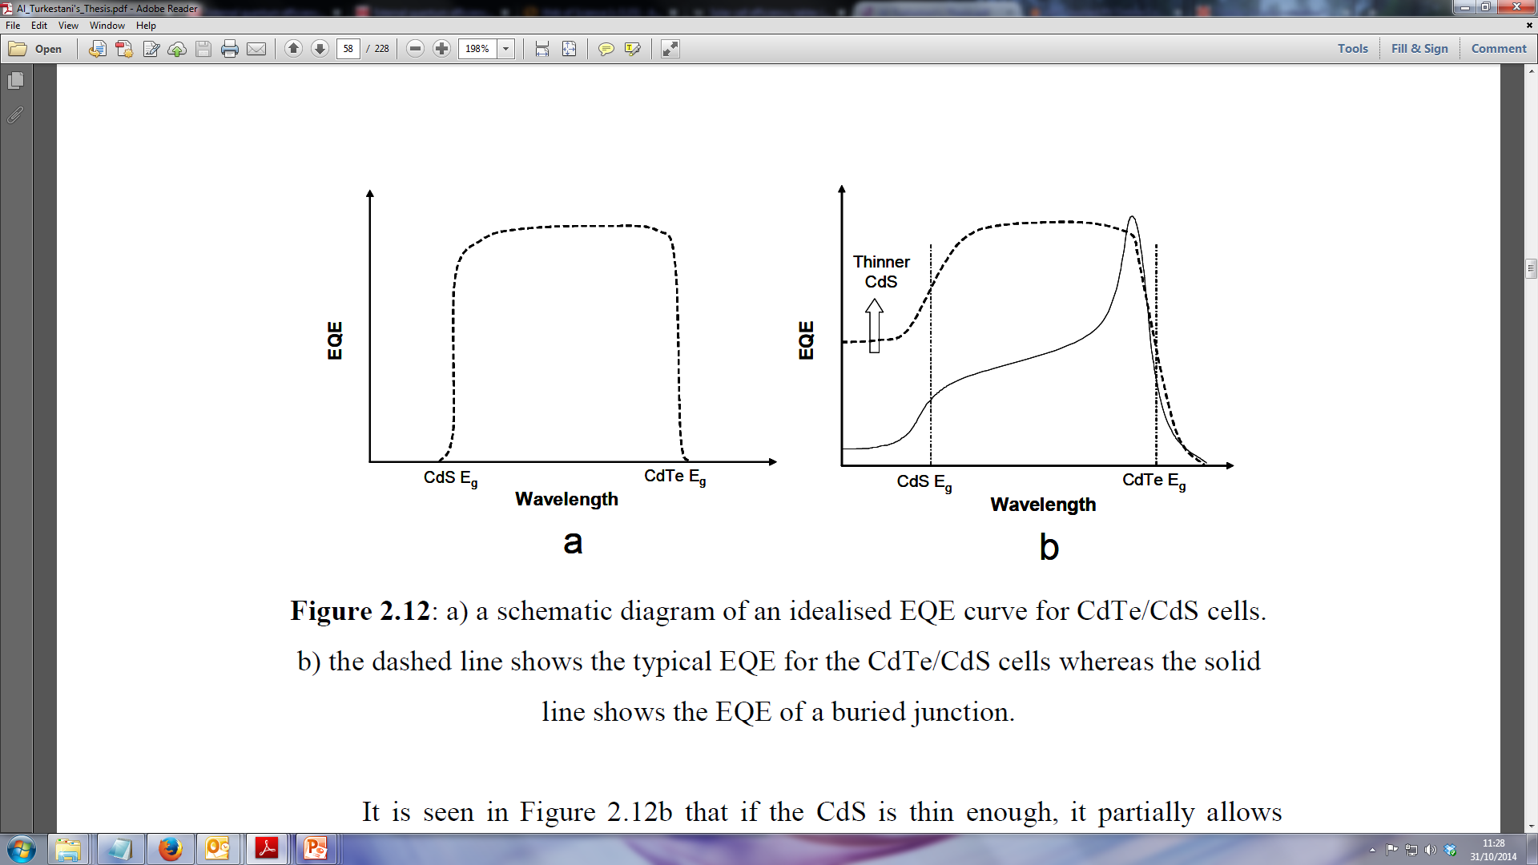
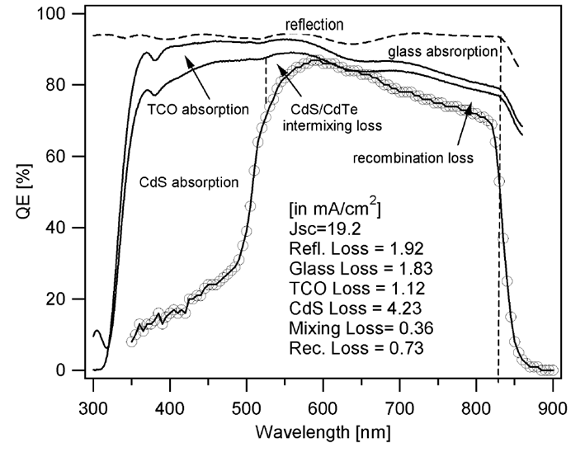
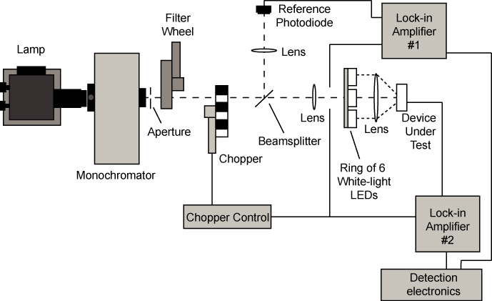
L6
Glass/ TCO
External quantum efficiency (EQE)
n-type CdS
Junction position
n-type CdTe
p-type CdTe

Slide 15
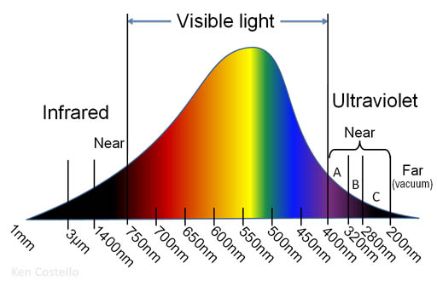
L6
External quantum efficiency (EQE)
AM1.5
AM1.5
Glass
Transparent conductive oxide (e.g. ITO)
Window layer (e.g. CdS)
Absorber layer (e.g. CdTe)
J_{SC}

Slide 16
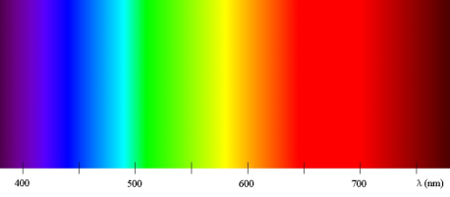
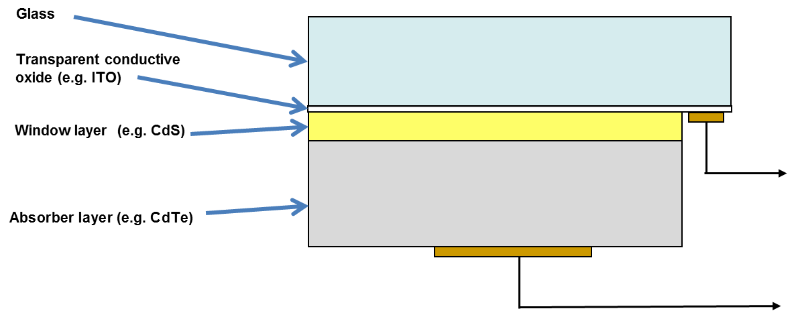
L6
External quantum efficiency (EQE)
A 100% EQE means every photon that strikes the cell generates an electron hole pair which flows through the external circuit
Define the EQE as the ratio of photons in to current generated

Slide 17
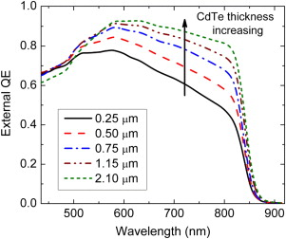
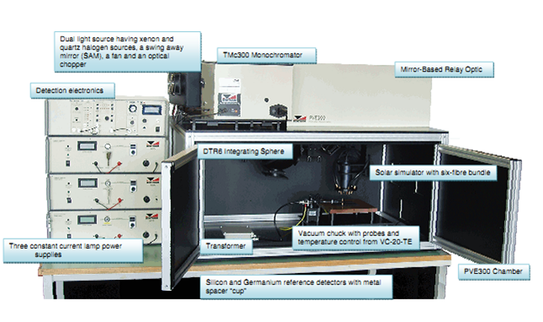
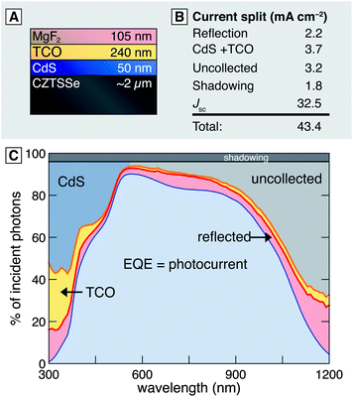
L6
External quantum efficiency (EQE)
Theoretical case
Area under curve proportional to J_{SC}

Slide 18
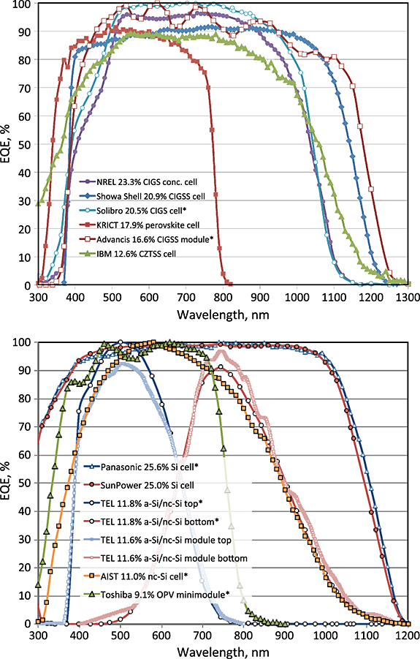
L6
External quantum efficiency (EQE)
Most solar cell technologies display same typical “top hat” EQE curve shape

Slide 19

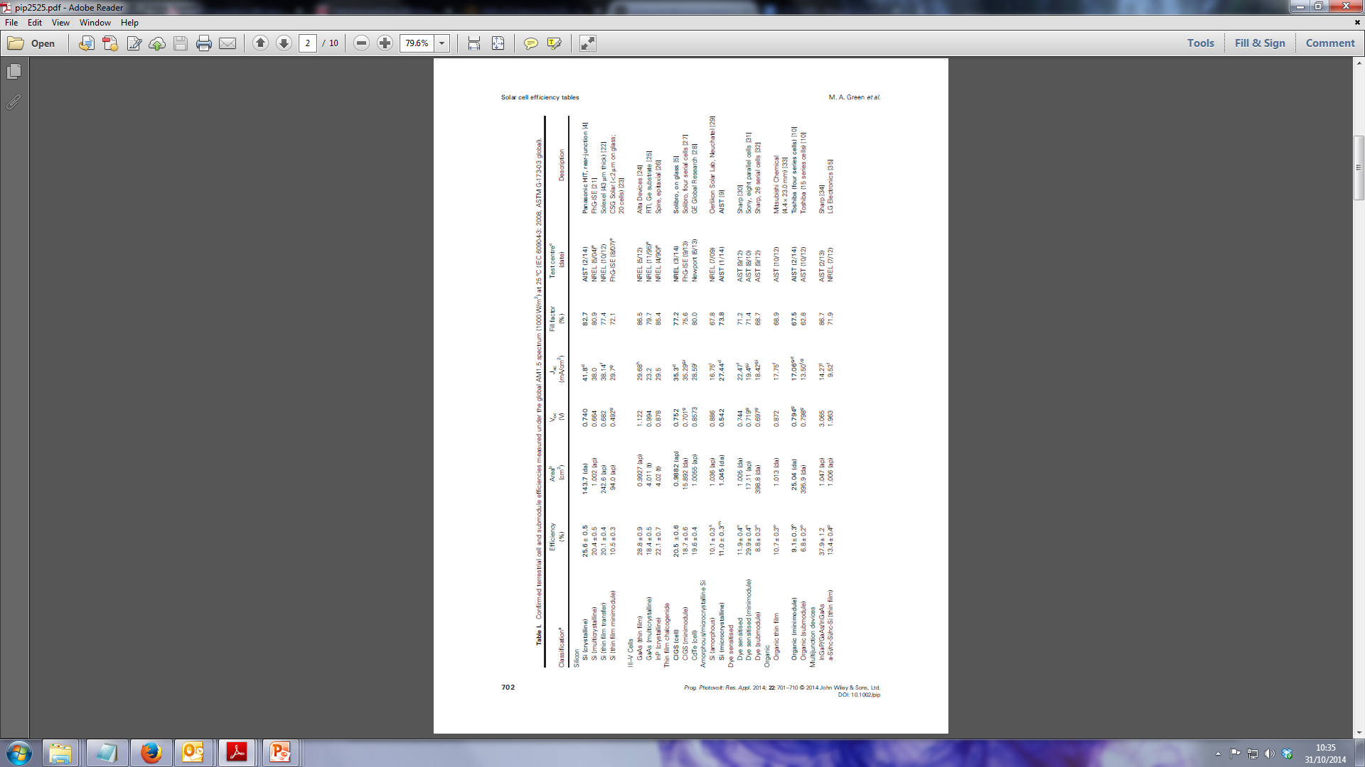
L6
External quantum efficiency (EQE)

Slide 20
L6
External quantum efficiency (EQE)
Glass
Transparent conductive oxide (e.g. ITO)
Window layer (e.g. CdS)
Absorber layer (e.g. CdTe)
J=0
Region 1: E_{photon}<E_{Asorber}

Slide 21
L6
External quantum efficiency (EQE)

Slide 22
L6
External quantum efficiency (EQE)
Glass
Transparent conductive oxide (e.g. ITO)
Window layer (e.g. CdS)
Absorber layer (e.g. CdTe)
J≠0
Region 2: E_{photon}>E_{Asorber}

Slide 23
L6
External quantum efficiency (EQE)

Slide 24
L6
External quantum efficiency (EQE)
Absorber bandgap

Slide 25
L6
External quantum efficiency (EQE)
Glass
Transparent conductive oxide (e.g. ITO)
Window layer (e.g. CdS)
Absorber layer (e.g. CdTe)
J=0
Region 3: E_{photon}>E_{window}

Slide 26
L6
External quantum efficiency (EQE)

Slide 27
L6
External quantum efficiency (EQE)
Window bandgap

Slide 28
L6
External quantum efficiency (EQE)
Real cells

Slide 29
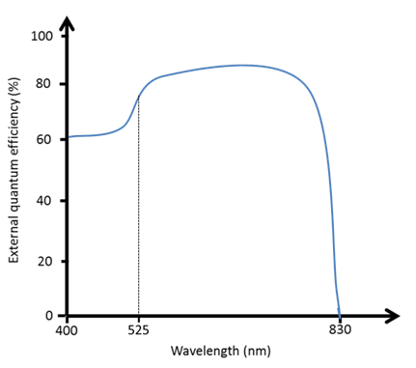
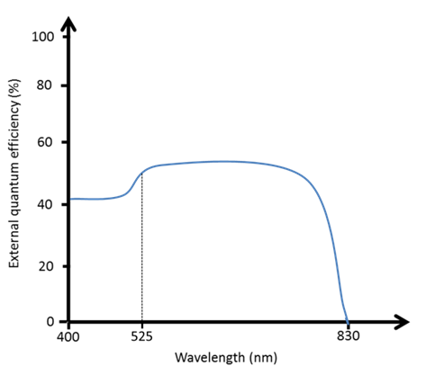
L6
External quantum efficiency (EQE)
Optical losses
High efficiency
Low efficiency
Uniform reduction in EQE signal across wavelength range is an indication of optical losses i.e. reflection loss, optical blockages etc.
Can also be an indication of poor system calibration.

Slide 30
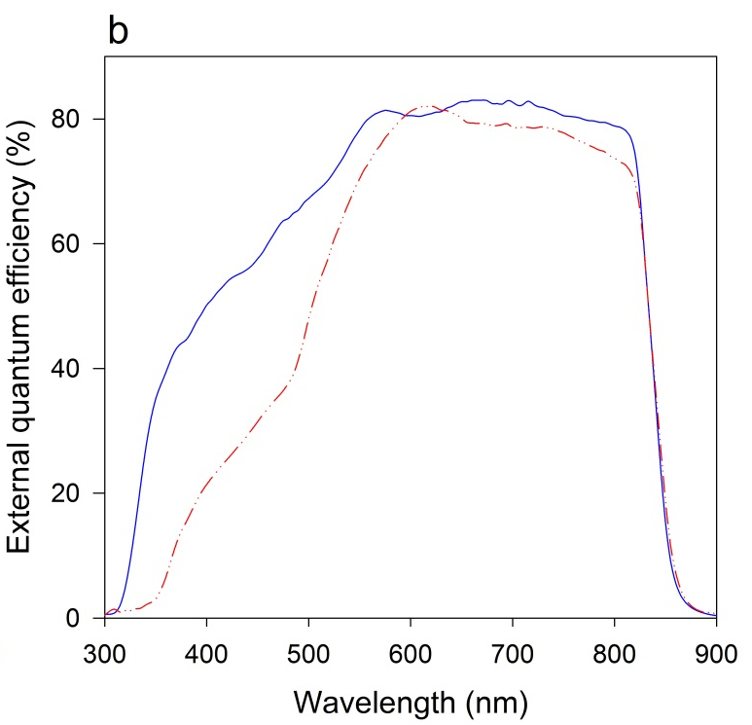
L6
External quantum efficiency (EQE)
window/ n-type layer losses
High efficiency
High efficiency
Lower efficiency
Lower efficiency
Reduced window layer thickness allows more light transmission to absorber
Higher bandgap n-type layer shifts absorption edge

Slide 31

L6
External quantum efficiency (EQE)
Deep penetration losses
If absorber layer is thin or depletion width is narrow then longer wavelength photons have an increased probability of not contributing to photocurrent. See a decrease in EQE for longer wavelengths.

Slide 32
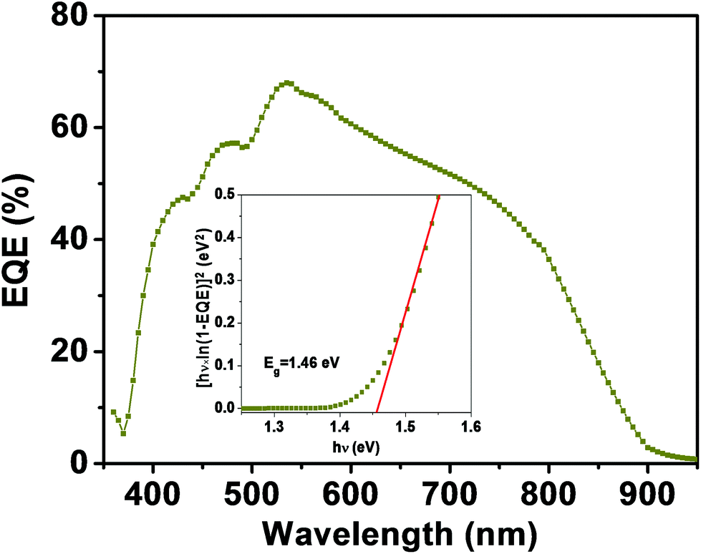
L6
External quantum efficiency (EQE)
Graded bandgap/back surface recombination
In multi component materials such as CZTS can get a broad cut-off region due to changes in the absorber bandgap.
This often signifies the material isn’t single phase and reduces the efficiency.
Can also indicate enhanced recombination close to the back surface.

Slide 33
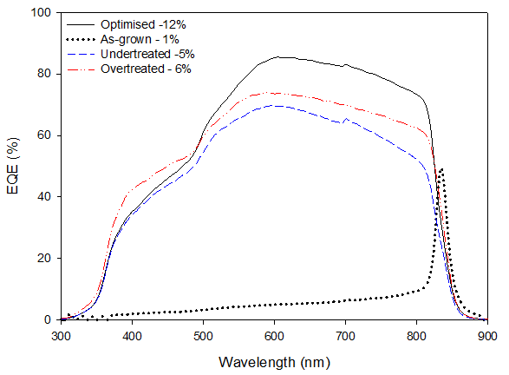
L6
External quantum efficiency (EQE)
In certain situations see a complete change in EQE that corresponds to very low performance
See reasonable EQE response near absorber band-edge but low response at all other wavelengths

Slide 34
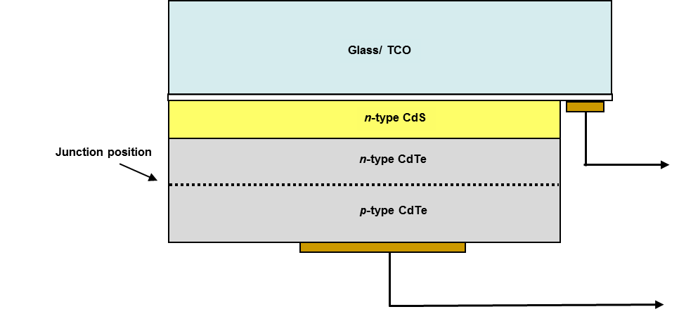
L6
External quantum efficiency (EQE)
This is a buried junction response due to both p and n type regions being present in the absorber layer

Slide 35
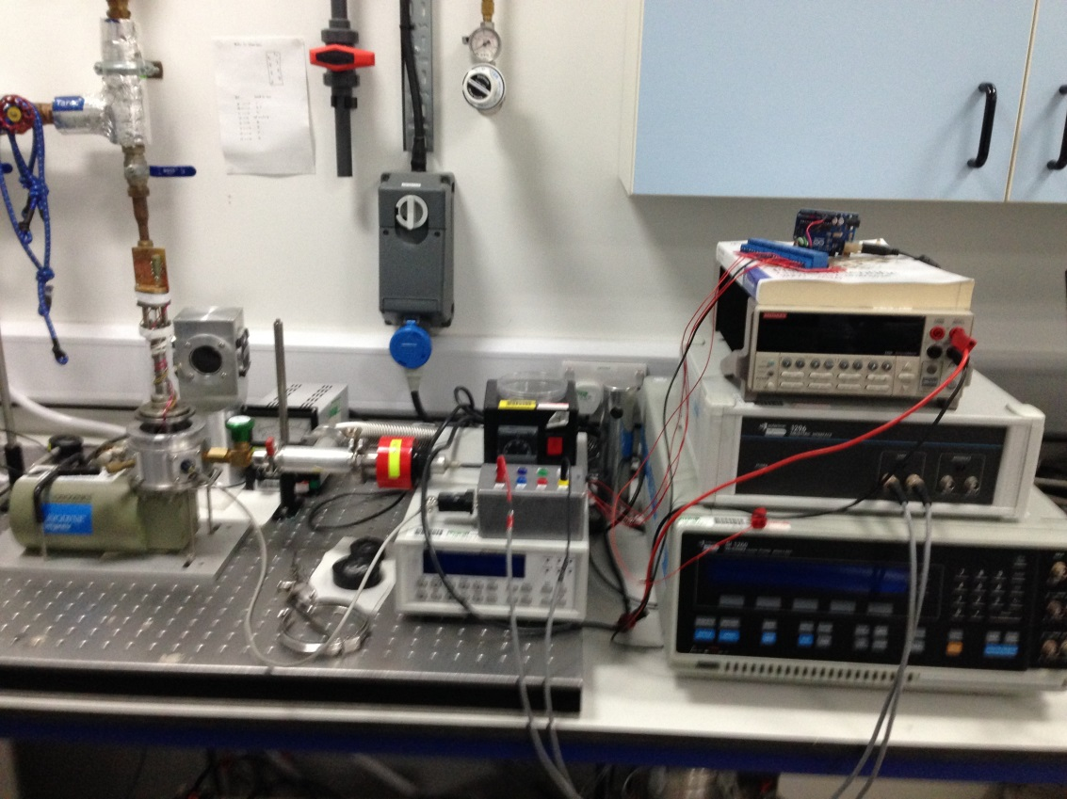
L6
Capacitance Voltage analysis (C-V)
Capacitance-voltage measurements are useful in deriving particular parameters about PV devices.
Depending on the type of solar cell, capacitance-voltage (C-V) measurements can be used to derive parameters such as the doping concentration
and the built-in voltage of the junction.
A capacitance-frequency (C-f) sweep can be used to provide information on the existence
of traps in the depletion region.
Liverpool CV/Admittance spectroscopy system

Slide 36
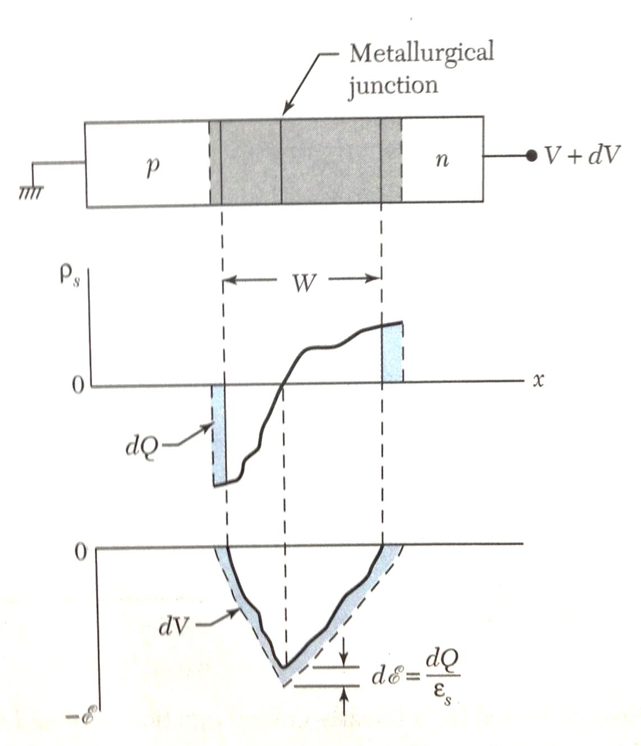
L6
Capacitance Voltage analysis (C-V)
Can treat a p-n junction as a capacitor - depletion region sandwiched between two plates.
Can define the junction capacitance per unit area as
Space charge
distribution
Field
distribution
Where W is the width of the depletion region and ε_{S} is the semiconductor permittivity

Slide 37
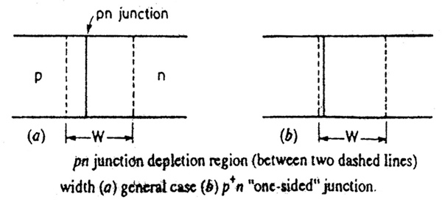
L6
Capacitance Voltage analysis (C-V)
We generally assume a one sided abrupt junction for calculations. This is due to the higher doping densities in the n-type layer meaning the depletion region lies within the p-type layer
For a one sided junction we can determine the depletion width as
Electron charge
Acceptor doping density
Using previous equation we get the relation
Hence we can get N_{a} from a plot of 1/C² vs V

Slide 38
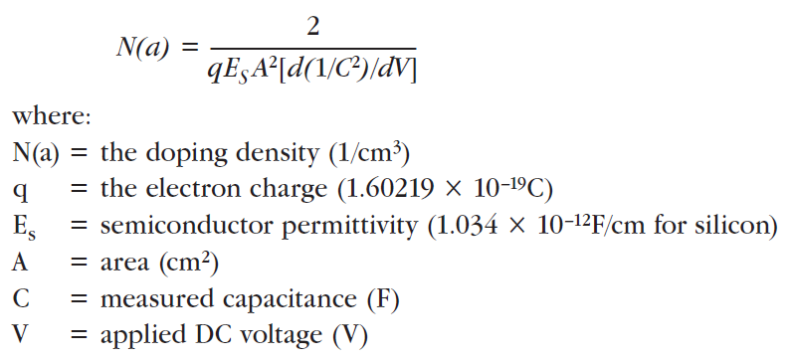
L6
Capacitance Voltage analysis (C-V)
Worked example – CdTe solar cell
Measure the capacitance response of the cell as a function of applied bias.
C-V measurements can be made either forward-biased or reverse biased. However, when the cell is forward-biased, the applied DC voltage must be limited; otherwise non-ohmic back contacts can alter the signal.
C vs. V plot
1/C² vs. V plot
Determine gradient of straight line fit around V=0

Slide 39
L6
Capacitance Voltage analysis (C-V)
p-type doping density is given by
We have included a contact area term A
So for a CdTe cell with 5mm diameter square contacts we measured a the slope of the 1/C² plot to be 2.7x10^{17.}
So CdTe doping density is

Slide 40
LX
Summary
Key junction characterisation techniques
JV – R_{S} and R_{SH} → can infer the issue
J-V-T – Back contact barrier height measurements
EQE – Layer behaviour and optical losses
CV - doping density of p-type layer

